Slide 1
CSE-201
Data Structure & Algorithm
Lecture - 1
Data Structure & Algorithm

Slide 2
Introduction to Data Structures
Data Structures
The logical or mathematical model of a particular organization of data is called a data
structure.
Types of Data Structure
1. Linear Data Structure
Example: Arrays, Linked Lists, Stacks, Queues
2. Nonlinear Data Structure
Example: Trees, Graphs
A
Array
A
B
C
D
E
F
Tree
B
C
D
E
F
Figure: Linear and nonlinear structures
Data Structure & Algorithm

Slide 3
Choice of Data Structures
The choice of data structures depends on two considerations:
It must be rich enough in structure to mirror the actual relationships of data in the real world.
The structure should be simple enough that one can effectively process data when necessary.
10
10
20
30
40
20
30
50
60
70
40
50
60
70
80
Figure 2: Array with 8 items
Figure 3: Tree with 8 nodes
Data Structure & Algorithm

Slide 4
Data Structure Operations
Traversing: Accessing each record exactly once so that certain items in the record may be processed.
2. Searching: Finding the location of the record with a given key value.
3. Inserting: Adding a new record to the structure.
4. Deleting: Removing a record from the structure.
5. Sorting: Arranging the records in some logical order.
6. Merging: Combing the records in two different sorted files into a single sorted file.
Data Structure & Algorithm

Slide 5
Algorithms
It is a well-defined set of instructions used to solve a particular problem.
Example:
Write an algorithm for finding the location of the largest element of an array Data.
Largest-Item (Data, N, Loc)
1. set k:=1, Loc:=1 and Max:=Data[1]
2. while k<=N repeat steps 3, 4
3. If Max < Data[k] then Set Loc:=k and Max:=Data[k]
4. Set k:=k+1
5. write: Max and Loc
6. exit
Data Structure & Algorithm

Slide 6
Complexity of Algorithms
The complexity of an algorithm M is the function f(n) which gives the running time and/or storage space requirement of the algorithm in terms of the size n of the input data.
Two types of complexity
1. Time Complexity
2. Space Complexity
Sometimes the choice of data structures involves a time-space tradeoff. By increasing the amount of space for storing the data, it is possible to reduce the time needed for processing the data, or vice versa.
Data Structure & Algorithm

Slide 7
Analyzing Algorithms
Predict the amount of resources required:
  memory: how much space is needed?
  computational time: how fast the algorithm runs?
FACT: running time grows with the size of the input
Input size (number of elements in the input)
  Size of an array, polynomial degree, # of elements in a matrix, # of bits in the binary representation of the input, vertices and edges in a graph
Def: Running time = the number of primitive operations (steps) executed before termination
  Arithmetic operations (+, -, *), data movement, control, decision making (if, while), comparison
Data Structure & Algorithm

Slide 8
Algorithm Analysis: Example
Alg.: MIN (a[1], …, a[n])
  m ← a[1];
  for i ← 2 to n
  if a[i] < m
  then m ← a[i];
Running time:
  the number of primitive operations (steps) executed before termination
  T(n) =1 [first step] + (n) [for loop] + (n-1) [if condition] +
  (n-1) [the assignment in then] = 3n - 1
Order (rate) of growth:
  The leading term of the formula
  Expresses the asymptotic behavior of the algorithm
Data Structure & Algorithm

Slide 9
Typical Running Time Functions
1 (constant running time):
  Instructions are executed once or a few times
logN (logarithmic)
  A big problem is solved by cutting the original problem in smaller sizes, by a constant fraction at each step
N (linear)
  A small amount of processing is done on each input element
N logN
  A problem is solved by dividing it into smaller problems, solving them independently and combining the solution
Data Structure & Algorithm

Slide 10
Typical Running Time Functions
N² (quadratic)
  Typical for algorithms that process all pairs of data items (double nested loops)
N³ (cubic)
  Processing of triples of data (triple nested loops)
N^{K} (polynomial)
2^{N} (exponential)
  Few exponential algorithms are appropriate for practical use
Data Structure & Algorithm

Slide 11
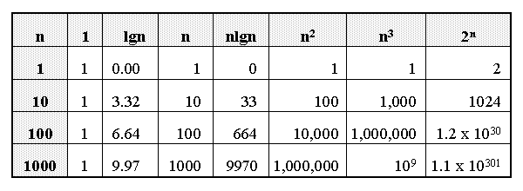
Growth of Functions
Data Structure & Algorithm

Slide 12
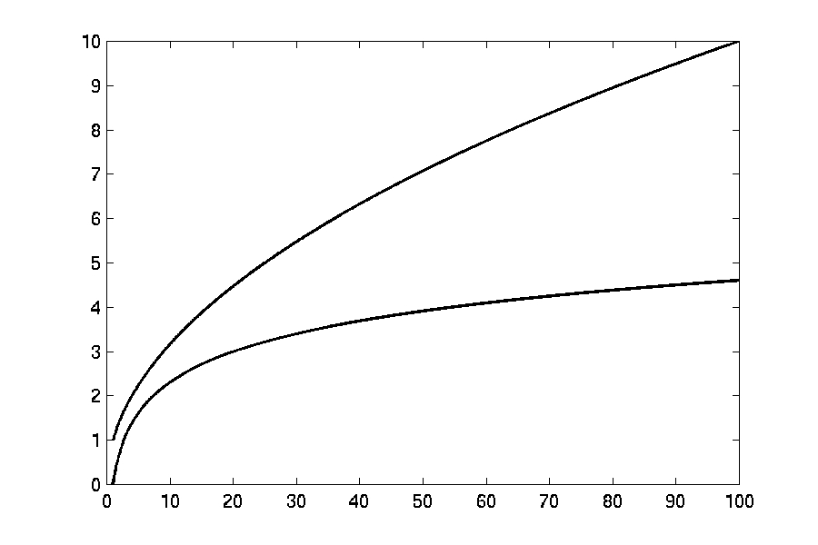

Complexity Graphs
log(n)
Data Structure & Algorithm

Slide 13
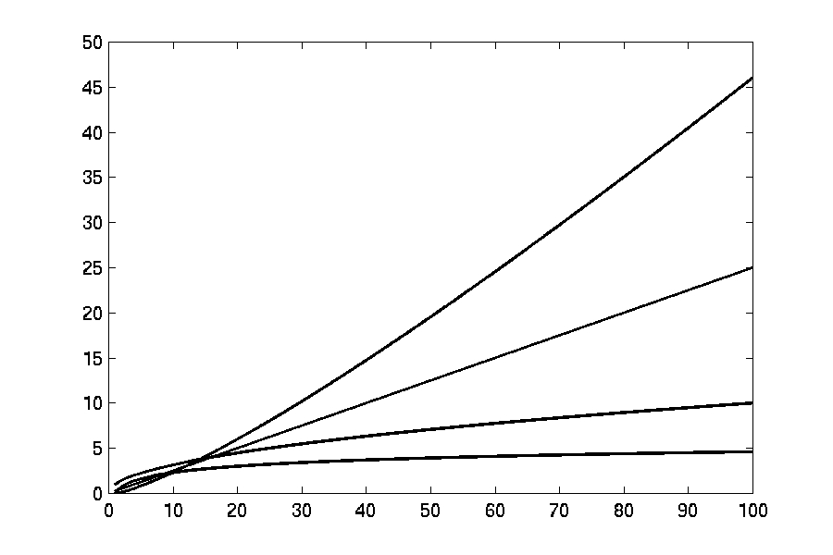
Complexity Graphs
n log(n)
n
log(n)
Data Structure & Algorithm

Slide 14
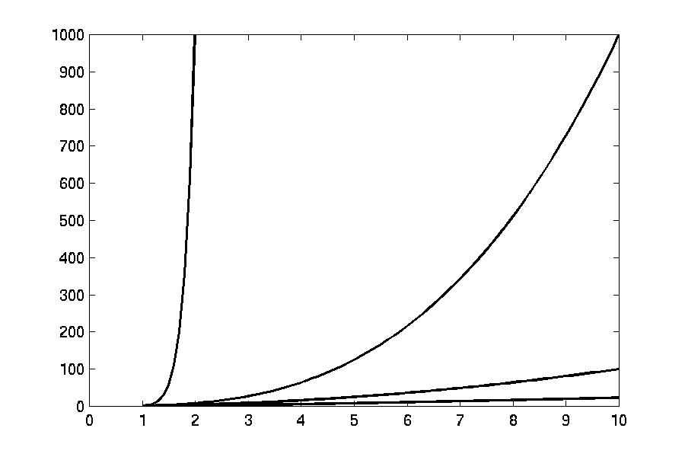
Complexity Graphs
n¹⁰
n³
n²
n log(n)
Data Structure & Algorithm

Slide 15
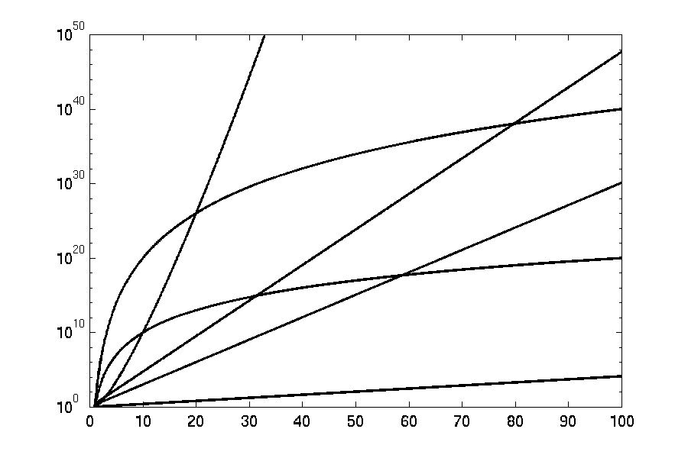
Complexity Graphs (log scale)
3^{n}
n^{n}
n²⁰
2^{n}
n¹⁰
1.1^{n}
Data Structure & Algorithm

Slide 16
Algorithm Complexity
Worst Case Complexity:
  the function defined by the maximum number of steps taken on any instance of size n
Best Case Complexity:
  the function defined by the minimum number of steps taken on any instance of size n
Average Case Complexity:
  the function defined by the average number of steps taken on any instance of size n
Data Structure & Algorithm

Slide 17
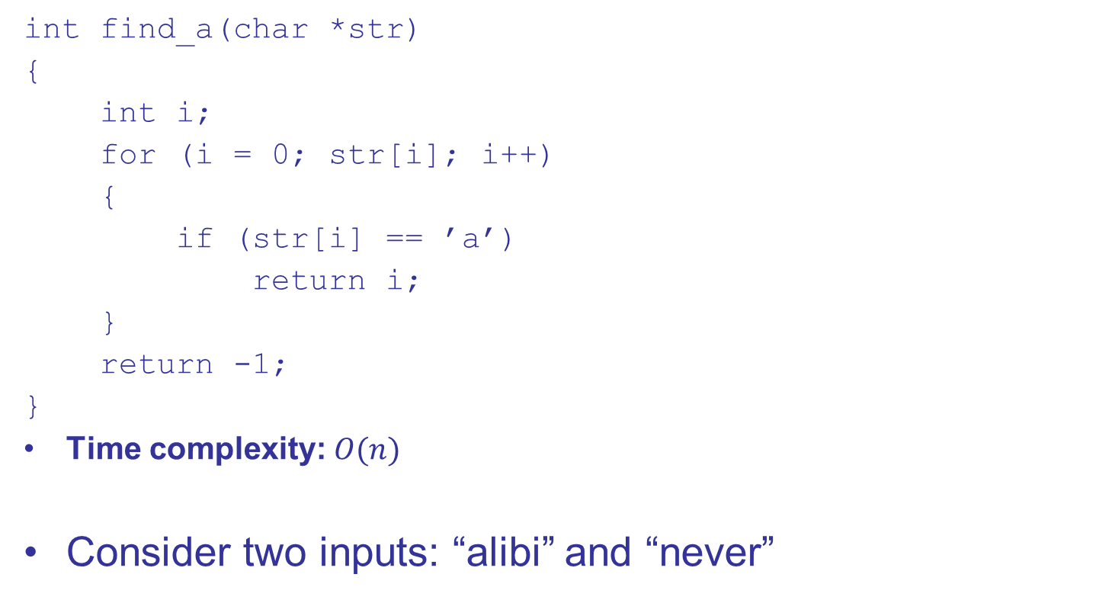
Is input size enough to determine time complexity unambiguously?
What is the time complexity of the above algorithm?
Depends on the input (str):
Θ(1) for best possible input which starts with ‘a’ e.g. when str = “alibaba”
Θ(n) for worst possible input which doesn’t contain any ‘a’ e.g. when str = “nitin”

Slide 18
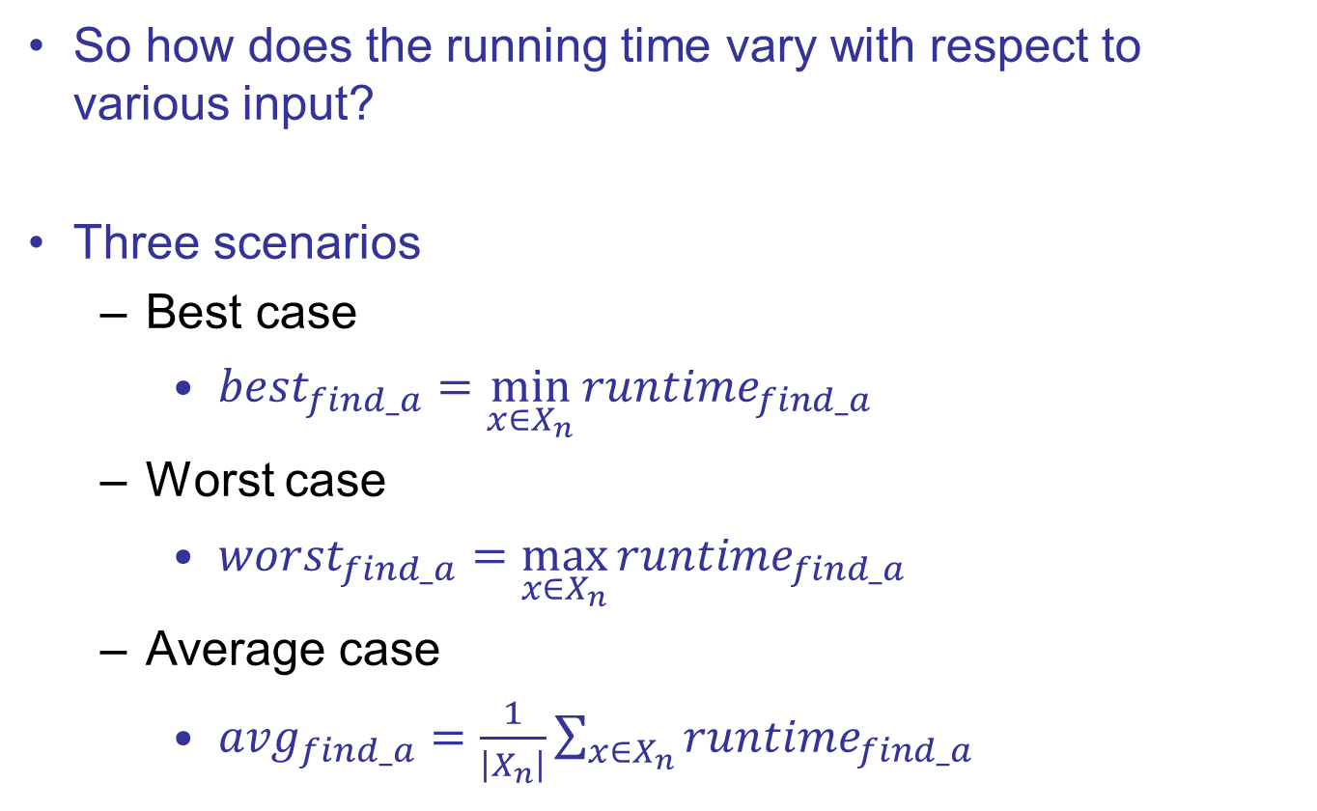
Types of Time Complexity Analysis

Slide 19
Types of Time Complexity Analysis
Worst-case: (usually done)
  Running time on worst possible input
Best-case: (bogus)
  Running time on best possible input
Average-case: (sometimes done)
  We take all possible inputs and calculate computing time for all of the inputs sum all the calculated values and divide the sum by total number of inputs
  We must know (or predict) distribution of inputs to calculate this
  Often we compute it on an assumed distribution of inputs using expectation, in which case it is called Expected running time
  This is typically calculated to show that although our algorithm’s worst case running time is not better, its expected time is better than its competitors
  Amortized running time (discussed later)
We are typically interested in the runtime of an algorithm in the worst case scenario. Because it provides us a guarantee that the algorithm won’t take any longer than this, no matter which input is given.

Slide 20
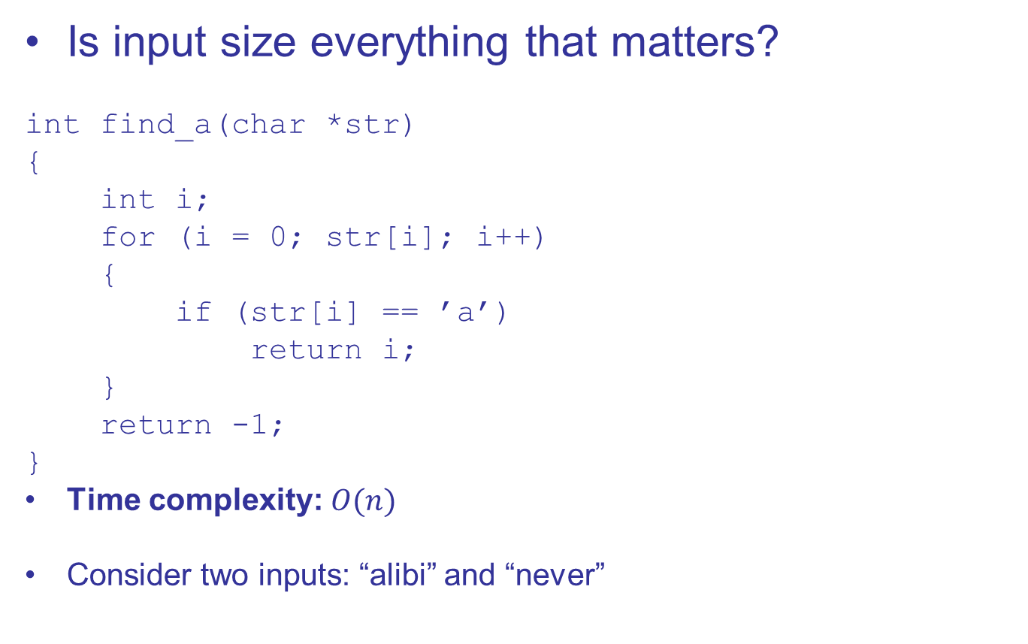
Example of Best & Worst Case Analysis
Best case input: strings that contain an ‘a’ in its first index
Best case time complexity: O(1)
Worst case input: strings that do not contain any ‘a’
Worst case time complexity: O(n)
Average time complexity: O(n), how?
Notes:
Proof of average case analysis is done in class

Slide 21
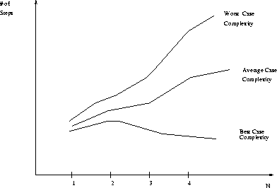
Best, Worst, and Average Case Complexity
Number of steps
Worst Case Complexity
Average Case Complexity
Best Case Complexity
N
(input size)
Data Structure & Algorithm

Slide 22
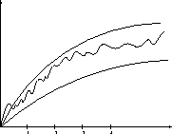
Doing the Analysis
It’s hard to estimate the running time exactly
  Best case depends on the input
  Average case is difficult to compute
  So we usually focus on worst case analysis
    Easier to compute
    Usually close to the actual running time
Strategy: find a function (an equation) that, for large n, is an upper bound to the actual function (actual number of steps, memory usage, etc.)
Upper bound
Actual function
Lower bound
Data Structure & Algorithm

Slide 23
Motivation for Asymptotic Analysis
An exact computation of worst-case running time can be difficult
  Function may have many terms:
    4n² - 3n log n + 17.5 n - 43 n^{⅔} + 75
An exact computation of worst-case running time is unnecessary
  Remember that we are already approximating running time by using RAM model
Data Structure & Algorithm

Slide 24
Classifying functions by their
Asymptotic Growth Rates (1/2)
asymptotic growth rate, asymptotic order, or
order of functions
  Comparing and classifying functions that ignores
    constant factors and
    small inputs.
The Sets big oh O(g), big theta Θ(g), big omega Ω(g)
Data Structure & Algorithm

Slide 25
Classifying functions by their
Asymptotic Growth Rates (2/2)
O(g(n)), Big-Oh of g of n, the Asymptotic Upper Bound;
Θ(g(n)), Theta of g of n, the Asymptotic Tight Bound; and
Ω(g(n)), Omega of g of n, the Asymptotic Lower Bound.
Data Structure & Algorithm

Slide 26
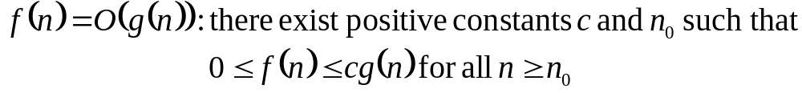
Big-O
What does it mean?
  If f(n) = O(n²), then:
    f(n) can be larger than n² sometimes, but…
    We can choose some constant c and some value n₀ such that for every value of n larger than n₀ : f(n) < cn²
    That is, for values larger than n₀, f(n) is never more than a constant multiplier greater than n²
    Or, in other words, f(n) does not grow more than a constant factor faster than n².
Data Structure & Algorithm

Slide 27
Visualization of O(g(n))
cg(n)
f(n)
n₀
Data Structure & Algorithm

Slide 28
Examples
  2n² = O(n³):
  n² = O(n²):
  1000n²+1000n = O(n²):
  n = O(n²):
2n² ≤ cn³ ⇒ 2 ≤ cn ⇒ c = 1 and n₀= 2
n² ≤ cn² ⇒ c ≥ 1 ⇒ c = 1 and n₀= 1
1000n²+1000n ≤ cn² ≤ cn²+ 1000n ⇒ c=1001 and n₀ = 1
n ≤ cn² ⇒ cn ≥ 1 ⇒ c = 1 and n₀= 1
Data Structure & Algorithm

Slide 29
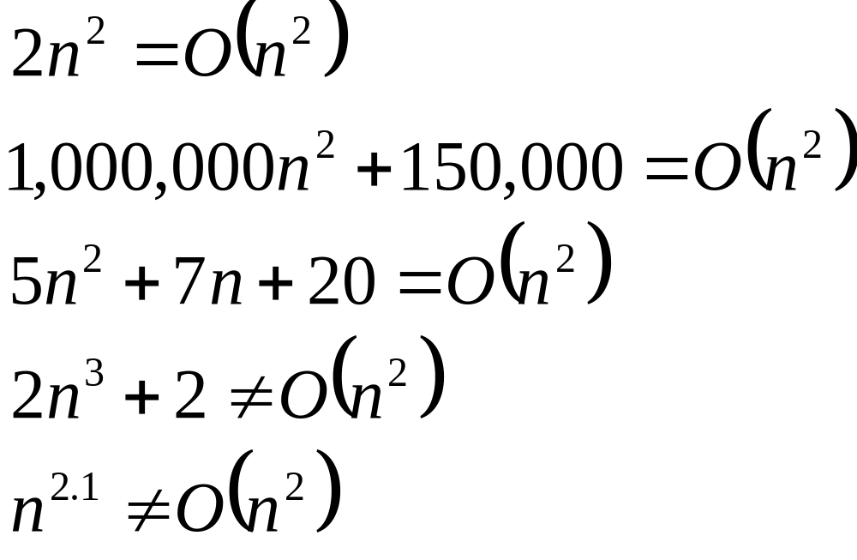
Big-O
Data Structure & Algorithm

Slide 30
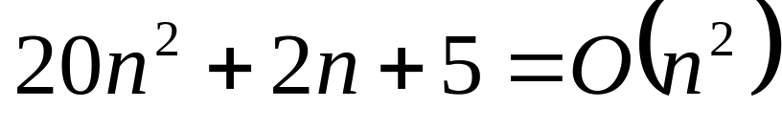
More Big-O
Prove that:
Let c = 21 and n₀ = 4
21n² > 20n² + 2n + 5 for all n > 4
n² > 2n + 5 for all n > 4
TRUE
Data Structure & Algorithm

Slide 31
Tight bounds
We generally want the tightest bound we can find.
While it is true that n² + 7n is in O(n³), it is more interesting to say that it is in O(n²)
Data Structure & Algorithm

Slide 32

Big Omega – Notation
Ω() – A lower bound
  n² = Ω(n)
  Let c = 1, n₀ = 2
  For all n ≥ 2, n² > 1 × n
Data Structure & Algorithm

Slide 33
Visualization of Ω(g(n))
f(n)
cg(n)
n₀
Data Structure & Algorithm

Slide 34
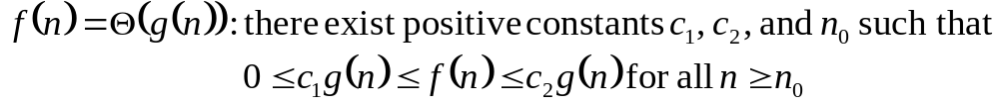
Θ-notation
Big-O is not a tight upper bound. In other words n = O(n²)
Θ provides a tight bound
In other words,
Data Structure & Algorithm

Slide 35
Visualization of Θ(g(n))
c₂g(n)
f(n)
c₁g(n)
n₀
Data Structure & Algorithm

Slide 36
A Few More Examples
n = O(n²) ≠ Θ(n²)
200n² = O(n²) = Θ(n²)
n^{2.5} ≠ O(n²) ≠ Θ(n²)
Data Structure & Algorithm

Slide 37
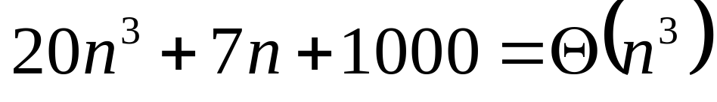
Example 2
Prove that:
Let c = 21 and n₀ = 10
21n³ > 20n³ + 7n + 1000 for all n > 10
n³ > 7n + 5 for all n > 10
TRUE, but we also need…
Let c = 20 and n₀ = 1
20n³ < 20n³ + 7n + 1000 for all n ≥ 1
TRUE
Data Structure & Algorithm

Slide 38
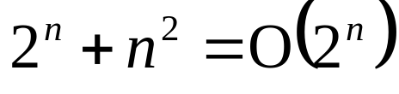
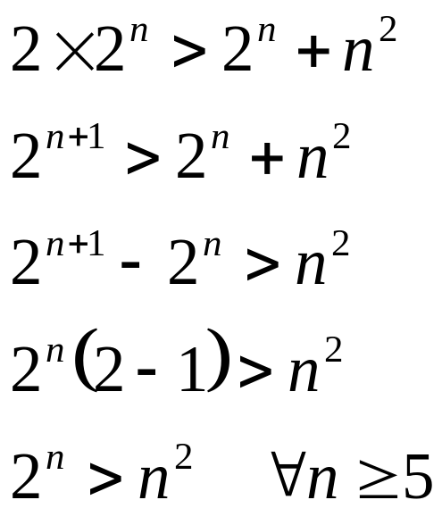
Example 3
Show that
Let c = 2 and n₀ = 5
✓
Data Structure & Algorithm

Slide 39
Asymptotic Notations - Examples
Θ notation
  n²/2 – n/2
  (6n³ + 1)lgn/(n + 1)
  n vs. n²
Ω notation
  n³ vs. n²
  n vs. logn
  n vs. n²
= Θ(n²)
= Θ(n²lgn)
n ≠ Θ(n²)
O notation
  2n² vs. n³
  n² vs. n²
  n³ vs. nlogn
n³ = Ω(n²)
2n² = O(n³)
n = Ω(logn)
n² = O(n²)
n ≠ Ω(n²)
n³ ≠ O(nlgn)
Data Structure & Algorithm

Slide 40
Asymptotic Notations - Examples
For each of the following pairs of functions, either f(n) is O(g(n)), f(n) is Ω(g(n)), or f(n) = Θ(g(n)). Determine which relationship is correct.
  f(n) = log n²; g(n) = log n + 5
  f(n) = n; g(n) = log n²
  f(n) = log log n; g(n) = log n
  f(n) = n; g(n) = log² n
  f(n) = n log n + n; g(n) = log n
  f(n) = 10; g(n) = log 10
  f(n) = 2^{n}; g(n) = 10n²
  f(n) = 2^{n}; g(n) = 3^{n}
f(n) = Θ (g(n))
f(n) = Ω(g(n))
f(n) = O(g(n))
f(n) = Ω(g(n))
f(n) = Ω(g(n))
f(n) = Θ(g(n))
f(n) = Ω(g(n))
f(n) = O(g(n))
Data Structure & Algorithm

Slide 41
Simplifying Assumptions
1. If f(n) = O(g(n)) and g(n) = O(h(n)), then f(n) = O(h(n))
2. If f(n) = O(kg(n)) for any k > 0, then f(n) = O(g(n))
3. If f₁(n) = O(g₁(n)) and f₂(n) = O(g₂(n)),
then f₁(n) + f₂(n) = O(max (g₁(n), g₂(n)))
4. If f₁(n) = O(g₁(n)) and f₂(n) = O(g₂(n)),
then f₁(n) * f₂(n) = O(g₁(n) * g₂(n))
Data Structure & Algorithm

Slide 42
Some Examples
Determine the time complexity for the following algorithm.
count = 0; //c₁
i = 0; //c₁
while(i < n){ //(n+1)c₂
count++; //nc₃
i++; //nc₃
}
So total time taken by this code,
T(n) = (2c₁ + c₂) + n (c₂+2c₃) which is ≤ (2c₁+ 2c₂+2c₃) n
for very large values of n. Therefore we say that the time complexity of this code is O(n).
Usually, when the code is very simple (like above), we simply say that the runtime of this code is O(n), without doing the straightforward mathematical analysis. When the code is not so simple, we do the actual analysis to compute the time complexity.

Slide 43
Some Examples
Determine the time complexity for the following algorithm.
count = 0;
for(i=0; i<10000; i++)
count++;

Slide 44
Some Examples
Determine the time complexity for the following algorithm.
count = 0;
for(i=0; i<10000; i++)
count++;
Θ(1)

Slide 45
Some Examples
Determine the time complexity for the following algorithm.
count = 0;
for(i=0; i<n; i++)
count++;

Slide 46
Some Examples
Determine the time complexity for the following algorithm.
count = 0;
for(i=0; i<n; i++)
count++;
Θ(n)

Slide 47
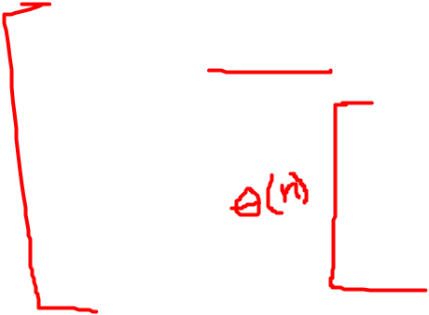
Some Examples
Determine the time complexity for the following algorithm.
sum = 0;
for(i=0; i<n; i++)
for(j=0; j<n; j++)
sum += arr[i][j];

Slide 48
Some Examples
Determine the time complexity for the following algorithm.
sum = 0;
for(i=0; i<n; i++)
for(j=0; j<n; j++)
sum += arr[i][j];
Θ(n²)

Slide 49
Some Examples
Determine the time complexity for the following algorithm.
sum = 0;
for(i=1; i<=n; i=i*2)
sum += i;

Slide 50
Some Examples
Determine the time complexity for the following algorithm.
sum = 0;
for(i=1; i<=n; i=i*2)
sum += i;
Θ(lg n)
WHY? Show mathematical analysis to prove that it is indeed Θ(lg n)
Notes:
Do analysis in class-note

Slide 51
Some Examples
Determine the time complexity for the following algorithm.
sum = 0;
for(i=1; i<=n; i=i*2)
for(j=0; j<n; j++)
sum += i*j;

Slide 52
Some Examples
Determine the time complexity for the following algorithm.
sum = 0;
for(i=1; i<=n; i=i*2)
for(j=0; j<n; j++)
sum += i*j;
Θ(n lg n)
Why? Outer for loop runs Θ(lg n) times (prove it!) and for each iteration of outer loop, the inner loop runs Θ(n) times

Slide 53
Some Examples
Determine the time complexity for the following algorithm.
sum = 0;
for(i=1; i<=n; i=i*2)
for(j=0; j<i; j++)
sum += i*j;

Slide 54
Some Examples
Determine the time complexity for the following algorithm.
sum = 0;
for(i=1; i<=n; i=i*2)
for(j=0; j<i; j++)
sum += i*j;
Loose Upper Bound: O(n lg n)
Tight Upper Bound: O(n)
Asymptotic Tight Bound: Θ(n)
WHY?

Slide 55
Recurrences
Def.: Recurrence = an equation or inequality that describes a function in terms of its value on smaller inputs, and one or more base cases
E.g.: T(n) = T(n-1) + n
Useful for analyzing recurrent algorithms
Methods for solving recurrences
  Substitution method
  Recursion tree method
  Master method
  Iteration method
Data Structure & Algorithm

